Slide 1
Agenda
Angular JS
Getting Started
Directives, Filters and Data Binding
Views, Controllers and Scope
Modules, Routes and Factories

Slide 2

http://angularjs.org

Slide 3

Notes:
First time I looked at it I felt like it was a little strange….but I could go with it.

Slide 4

Notes:
As I researched more I came across some things that looked really strange and just didn't click with me.

Slide 5

?
Transclusion
Restriction
Scope
Directive
Linking
Notes:
I saw a lot of words that were confusing and after more research I started to get a little frustrated…kind of felt like this kid.

Slide 6

Notes:
But, I stuck with it, kept on researching and playing around with the samples, took a deep breath and….

Slide 7

Notes:
I chilled out, and once a few things started to click I started to realize that I could really take advantage of some great features!

Slide 8

Notes:
Once you have that "light bulb moment" you realize how powerful and flexible AngularJS is. That's when it truly changes how you think about writing Single Page Applications (SPAs) and client-side applications in general.

Slide 9

Notes:
And then at some point it hit me – this framework is really powerful!

Slide 10
Getting Started

Slide 11





Single Page Application (SPA)
SPA Demo
http://www.myspa.com
View
View
View
View

Slide 12

The Challenge with SPAs
DOM Manipulation
History
Module Loading
Routing
Caching
Object Modeling
Data Binding
Ajax/Promises
View Loading

Slide 13



Slide 14

Data Binding
MVC
Routing
Testing
jqLite
Templates
History
Factories
ngularJS is a full-featured SPA framework
ViewModel
Controllers
Views
Directives
Controllers
Dependency Injection
Validation

Slide 15
What is AngularJS
MVC Javascript Framework by Google for Rich Web Application Development

Slide 16
Why AngularJS
“Other frameworks deal with HTML’s shortcomings by either abstracting away HTML, CSS, and/or JavaScript or by providing an imperative way for manipulating the DOM. Neither of these address the root problem that HTML was not designed for dynamic views”.
Structure, Quality and Organization
Lightweight ( < 36KB compressed and minified)
Free
Separation of concern
Modularity
Extensibility & Maintainability
Reusable Components
“ HTML? Build UI Declaratively! CSS? Animations! JavaScript? Use it the plain old way!”

Slide 17
jQuery
Allows for DOM Manipulation
Does not provide structure to your code
Does not allow for two way binding

Slide 18
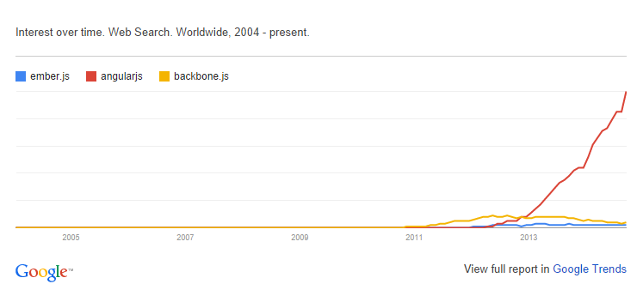
Other Javascript MV* Frameworks
BackboneJS
EmberJS

Slide 19
Features of AngularJS
Two-way Data Binding – Model as single source of truth
Directives – Extend HTML
MVC
Dependency Injection
Testing
Deep Linking (Map URL to route Definition)
Server-Side Communication

Slide 20
Data Binding
<html ng-app>
<head>
<script src='angular.js'></script>
</head>
<body>
<input ng-model='user.name'>
<div ng-show='user.name'>Hi {{user.name}}</div>
</body>
</html>

Slide 21
MVC
Model (Data)
View (UI)
Notifies
Notifies
Changes
Controller (Logic)

Slide 22
MVC
Model
JS Objects
View
DOM
Controller
JS Classes

Slide 23
MVC
<html ng-app>
<head>
<script src='angular.js'></script>
<script src='controllers.js'></script>
</head>
<body ng-controller='UserController'>
<div>Hi {{user.name}}</div>
</body>
</html>
function XXXX($scope) {
$scope.user = { name:'Larry' };
}

Slide 24
Hello Javascript
<p id="greeting1"></p>
<script>
var isIE = document.attachEvent;
var addListener = isIE
? function(e, t, fn) {
e.attachEvent('on' + t, fn);}
: function(e, t, fn) {
e.addEventListener(t, fn, false);};
addListener(document, 'load', function(){
var greeting = document.getElementById('greeting1');
if (isIE) {
greeting.innerText = 'Hello World!';
} else {
greeting.textContent = 'Hello World!';
}
});
</script>

Slide 25
Hello JQuery
<p id="greeting2"></p>
<script>
$(function(){
$('#greeting2').text('Hello World!');
});
</script>

Slide 26
Hello AngularJS
<p ng:init="greeting = 'Hello World!'">{{greeting}}</p>
<p ng:init="greeting = 'Hello World!'">{{greeting}}</p>

Slide 27
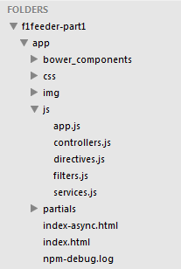
App Skeleton

Slide 28
Sample Angular Powered View
<body ng-app="F1FeederApp" ng-controller="driversController">
<table>
<thead>
<tr><th colspan="4">Drivers Championship Standings</th></tr>
</thead>
<tbody>
<tr ng-repeat="driver in driversList">
<td>{{$index + 1}}</td>
<td>
<img src="img/flags/{{driver.Driver.nationality}}.png" />
{{driver.Driver.givenName}}&nbsp;{{driver.Driver.familyName}}
</td>
<td>{{driver.Constructors[0].name}}</td>
<td>{{driver.points}}</td>
</tr>
</tbody>
</table>
</body>

Slide 29
Expressions
Expressions allow you to execute some computation in order to return a desired value.
{{ 1 + 1 }}
{{ 946757880 | date }}
{{ user.name }}
you shouldn’t use expressions to implement any higher-level logic.

Slide 30
Directives
Directives are markers (such as attributes, tags, and class names) that tell AngularJS to attach a given behaviour to a DOM element (or transform it, replace it, etc.)
Some angular directives
The ng-app - Bootstrapping your app and defining its scope.
The ng-controller - defines which controller will be in charge of your view.
The ng-repeat - Allows for looping through collections

Slide 31
Directives as Components
<rating max='5' model='stars.average'>
<tabs>'>
<tab title='Active tab' view='...'>
<tab title='Inactive tab' view='...'>
</tabs>
<tooltip content='messages.tip1

Slide 32
Adding Controllers
angular.module('F1FeederApp.controllers', []).
controller('driversController', function($scope) {
$scope.driversList = [
{
Driver: {
givenName: ‘Aarush,
familyName: ‘Tambade'
},
points: 322,
nationality: “Indian",
Constructors: [
{name: "Red Bull"}
]
},
{
Driver: {
givenName: ‘Ojas,
familyName: ‘Tambade'
},
points: 207,
nationality: “Indian",
Constructors: [
{name: "Ferrari"}
]
}
];
});
The $scope variable – Link your controllers and view

Slide 33
App.js
angular.module('F1FeederApp', [ 'F1FeederApp.controllers‘ ]);
Initializes our app and register the modules on which it depends

Slide 34
Index.html
<body ng-app="F1FeederApp" ng-controller="driversController">
<table>
<thead>
<tr><th colspan="4">Drivers Championship Standings</th></tr>
</thead>
<tbody>
<tr ng-repeat="driver in driversList">
<td>{{$index + 1}}</td>
<td>
<img src="img/flags/{{driver.Driver.nationality}}.png" />
{{driver.Driver.givenName}}&nbsp;{{driver.Driver.familyName}}
</td>
<td>{{driver.Constructors[0].name}}</td>
<td>{{driver.points}}</td>
</tr>
</tbody>
</table>
<script src="bower_components/angular/angular.js"></script>
<script src="bower_components/angular-route/angular-route.js"></script>
<script src="js/app.js"></script>
<script src="js/services.js"></script>
<script src="js/controllers.js"></script>
</body>
</html>

Slide 35
Loading data from the server(services.js)
angular.module('F1FeederApp.services', []).
factory(‘TFLAPIservice', function($http) {
var ergastAPI = {};
ergastAPI.getDrivers = function() {
return $http({
method: 'JSONP',
url: 'http://transflower/api/f1/2016/driverStandings.json?callback=JSON_CALLBACK'
});
}
return ergastAPI;
});
$http - a layer on top of XMLHttpRequest or JSONP
$resource - provides a higher level of abstraction
Dependency Injection
we create a new module (F1FeederApp.services) and register a service within that module (TFLAPIservice).

Slide 36
Modified controller.js
angular.module('F1FeederApp.controllers', []).
controller('driversController', function($scope, ergastAPIservice) {
$scope.nameFilter = null;
$scope.driversList = [];
TFLAPIservice.getDrivers().success(function (response) {
//Dig into the responde to get the relevant data
$scope.driversList = response.MRData.StandingsTable.StandingsLists[0].DriverStandings;
});
});

Slide 37
Routes
$routeProvider – used for dealing with routes
Modified app.js
angular.module('F1FeederApp', [
'F1FeederApp.services',
'F1FeederApp.controllers',
'ngRoute'
]).
config(['$routeProvider', function($routeProvider) {
$routeProvider.
when("/drivers", {templateUrl: "partials/drivers.html", controller: "driversController"}).
when("/drivers/:id", {templateUrl: "partials/driver.html", controller: "driverController"}).
otherwise({redirectTo: '/drivers'});
}]);

Slide 38
Partial views
<!DOCTYPE html>
<html>
<head>
<title>F-1 Feeder</title>
</head>
<body ng-app="F1FeederApp">
<ng-view></ng-view>
<script src="bower_components/angular/angular.js"></script>
<script src="bower_components/angular-route/angular-route.js"></script>
<script src="js/app.js"></script>
<script src="js/services.js"></script>
<script src="js/controllers.js"></script>
</body>
</html>

Slide 39
Advanced AngularJS Concept
Dependency Injection
Modularity
Digesting
Scope
End to End Testing
Promises
Localization
Filters

Slide 40
What are Directives?
They teach HTML new tricks!

Slide 41
Using Directives and Data Binding
Directive
<!DOCTYPE html>
<html ng-app>
<head>
<title></title>
</head>
<body>
<div class="container">
Name: <input type="text" ng-model="name" /> {{ name }}
</div>
<script src="Scripts/angular.js"></script>
</body>
</html>
Directive
Data Binding Expression

Slide 42
Iterating with the ng-repeat Directive
<html data-ng-app="">
...
<div class="container" data-ng-init="names=[‘Omkar','Nupur',‘Vikas',‘Shiva']">
<h3>Looping with the ng-repeat Directive</h3>
<ul>
<li data-ng-repeat="name in names">{{ name }}</li>
</ul>
</div>
...
</html>
Iterate through names

Slide 43
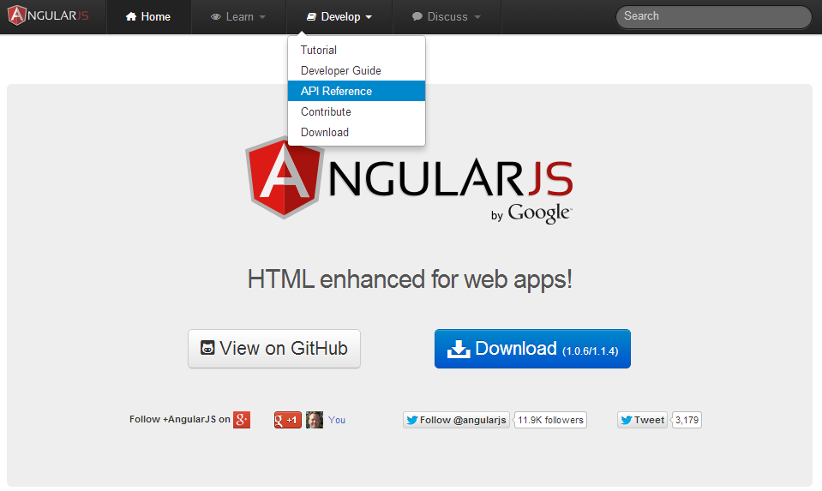
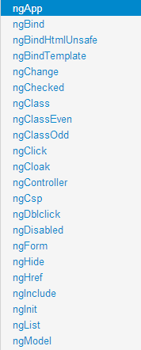
AngularJS Help for Directives

Slide 44
Using Filters
<ul>
<li data-ng-repeat="cust in customers | orderBy:'name'"> {{ cust.name | uppercase }} </li>
</ul>
Order customers by name property
Filter customers by model value
<input type="text" data-ng-model="nameText" />
<ul>
<li data-ng-repeat="cust in customers | filter:nameText | orderBy:'name'"> {{ cust.name }} - {{ cust.city }}</li>
</ul>

Slide 45
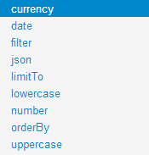
AngularJS Help for Filters

Slide 46

Demo

Slide 47
Views, Controllers
and Scope

Slide 48

View, Controllers and Scope
$scope
View
Controller
$scope is the "glue" (ViewModel) between a controller and a view

Slide 49
Creating a View and Controller
<div class="container" data-ng-controller="SimpleController">
<h3>Adding a Simple Controller</h3>
<ul>
<li data-ng-repeat="cust in customers"> {{ cust.name }} - {{ cust.city }} </li>
</ul>
</div>
<script>
function SimpleController($scope) { $scope.customers = [
{ name: ‘Shiv Varma', city: ‘Delhi' },
{ name: ‘Ramakant Debata', city: ‘Puri' },
{ name: ‘Sangita More', city: ‘Nagpur' },
{ name: ‘Raj Patil', city: ‘Pune' }
];
}
</script>
Define the controller to use
Access $scope
$scope injected dynamically
Basic controller

Slide 50
Demo

Slide 51
Modules, Routes
and Factories

Slide 52
Module
Config
Routes
View
$scope
Controller
Directives
*Factory

Slide 53
Modules are Containers
<html ng-app="moduleName">
Module
Config
Filter
Directive
Factory
Controller
Service
Routes
Provider
Value

Slide 54
Creating a Module
What's the Array for?
var demoApp = angular.module('demoApp', []);
var demoApp = angular.module('demoApp',
['helperModule']);
Module that demoApp depends on

Slide 55
Creating a Controller in a Module
var demoApp = angular.module('demoApp', []);
demoApp.controller('SimpleController', function ($scope) {
$scope.customers = [
{ name: Raj Kiran', city: ‘Pune' },
{ name: ‘Samanta Kumar', city: ‘Kolhapur' },
{ name: ‘Shrirang Jadhav', city: ‘Delhi' },
{ name: 'Tushar Patil', city: ‘Nashik' }
];
});
Define a Module
Define a Controller

Slide 56
The Role of Routes
SPA Demo
http://www.myspa.com
View1
/view2
View2
/view3
/view1
View4
/view4
View3

Slide 57
Defining Routes
var demoApp = angular.module('demoApp', ['ngRoute']);
demoApp.config(function ($routeProvider) {
$routeProvider
.when('/',
{
controller: 'SimpleController',
templateUrl:'View1.html'
})
.when('/view2',
{
controller: 'SimpleController',
templateUrl:'View2.html'
})
.otherwise({ redirectTo: '/' });
});
Define Module Routes

Slide 58
Where do Views Go in a Page?
Dynamically loaded views are injected into the shell page as a module loads:
SPA Demo
http://www.myspa.com
<div ng-view></div>
View1
OR
<ng-view></ng-view>

Slide 59
The Role of Factories
var demoApp = angular.module('demoApp', [])
.factory('simpleFactory', function () {
var factory = {};
var customers = [ ... ];
factory.getCustomers = function () {
return customers;
};
return factory;
})
.controller('SimpleController', function ($scope, simpleFactory) {
$scope.customers = simpleFactory.getCustomers();
});
Factory injected into controller at runtime

Slide 60
Module
Config
Routes
View
$scope
Controller
Directives
*Factory

